Slide 1
SCREENSHOTS
BUILDING BUS RESERVATION SYSTEM USING
PYTHON AND DJANGO(Sathya-5113)

Slide 2
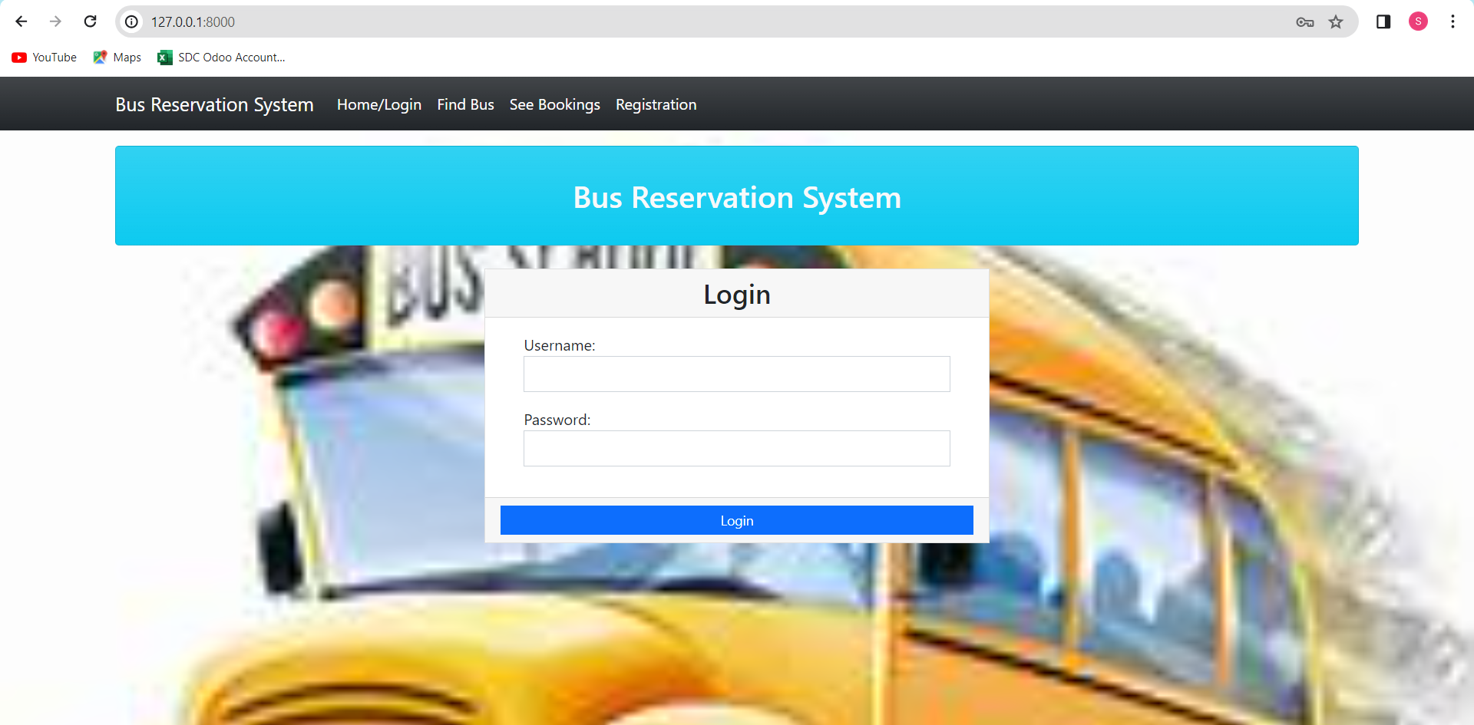
Homepage

Slide 3
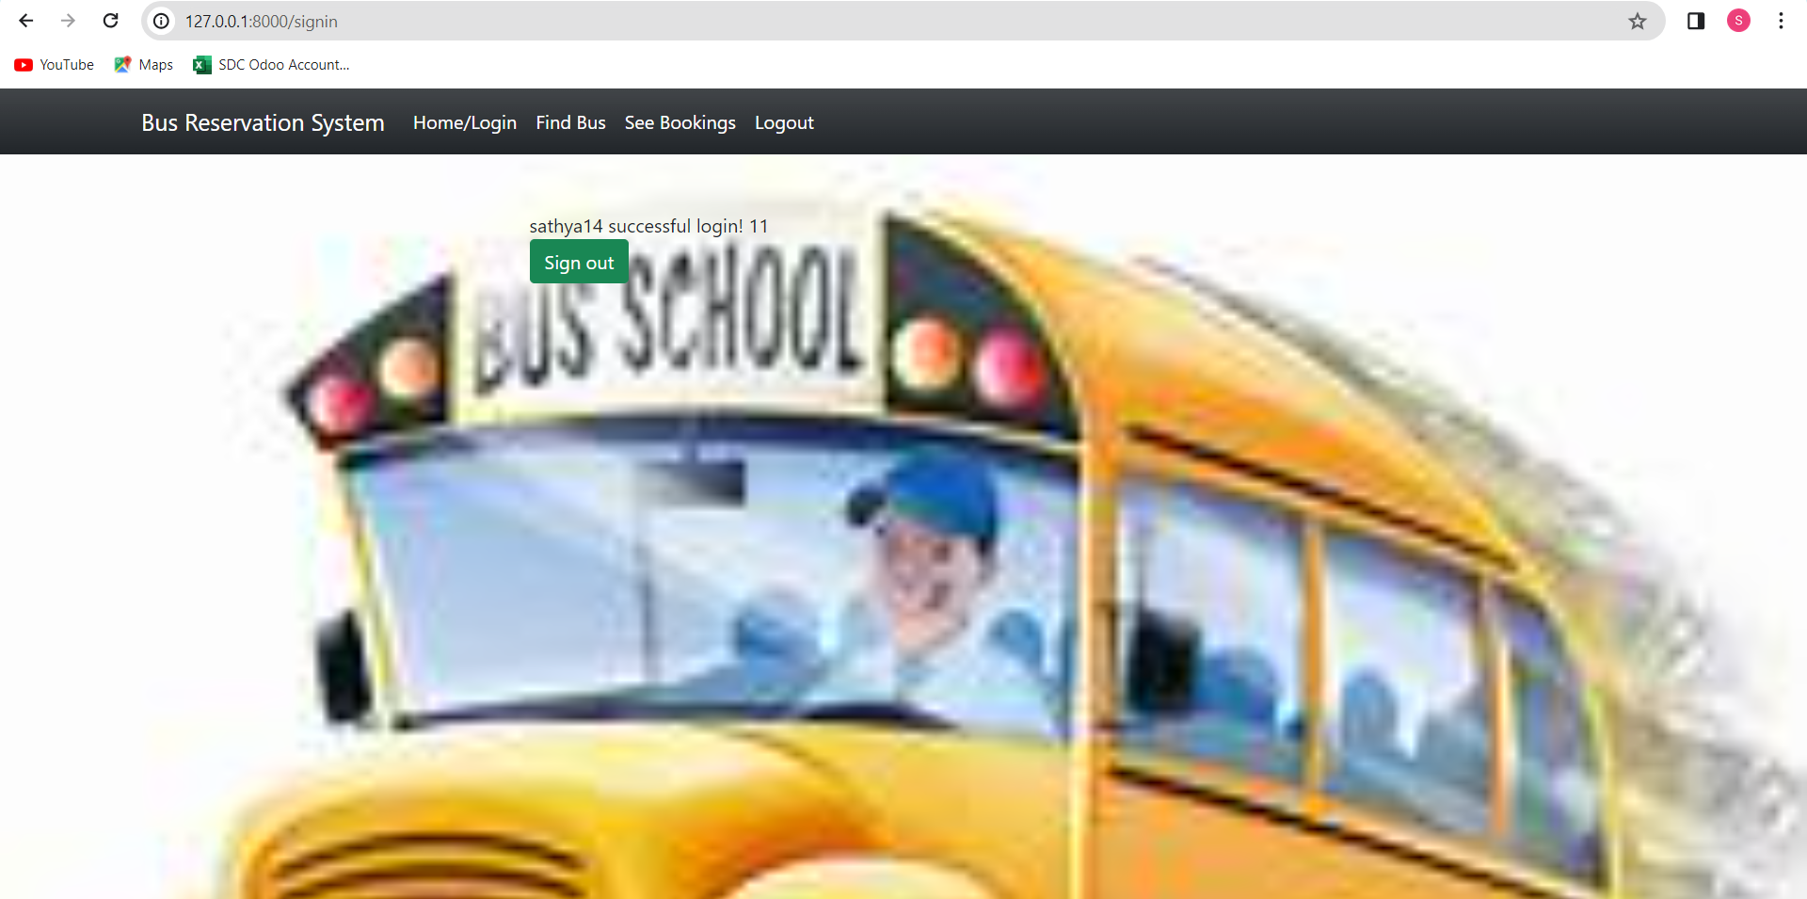
Admin page
Screenshots

Slide 4
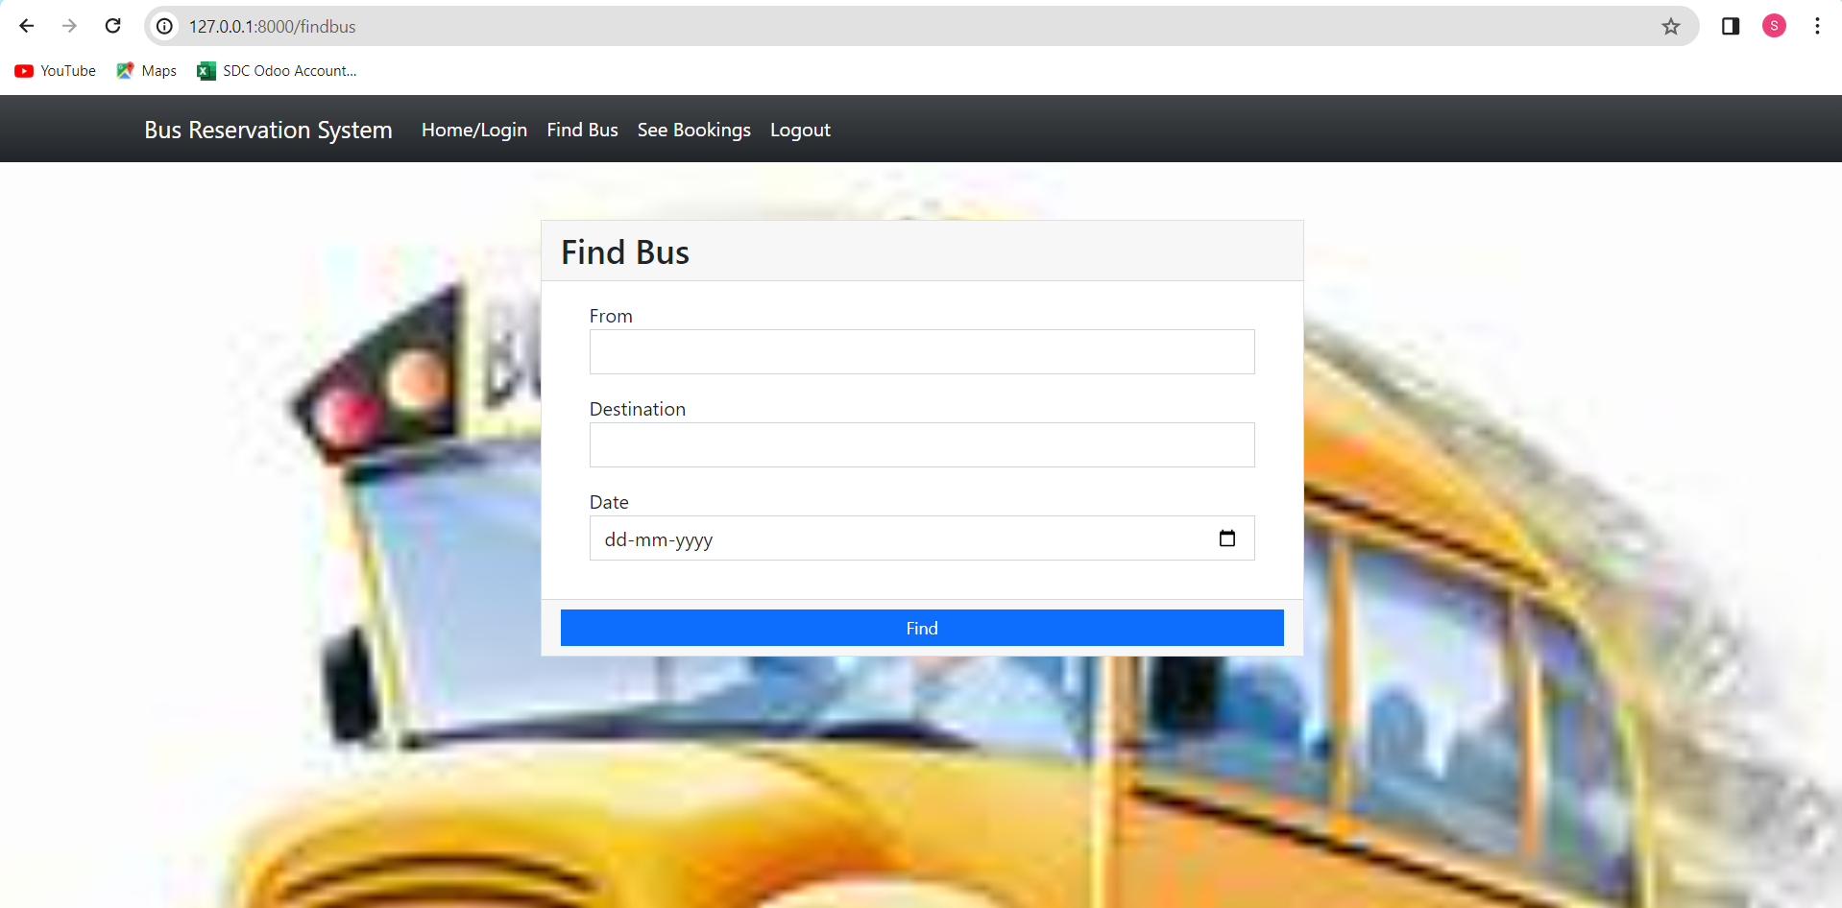
Finding bus

Slide 5
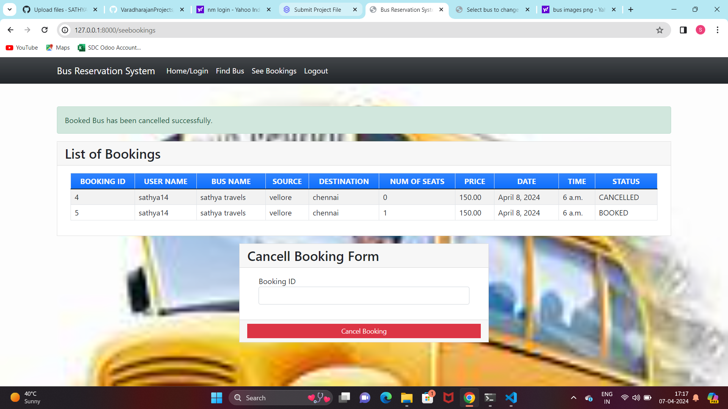
Bookings

